Slide 1
Streaming Flight Data
Jean Paul Azzopardi

Slide 2
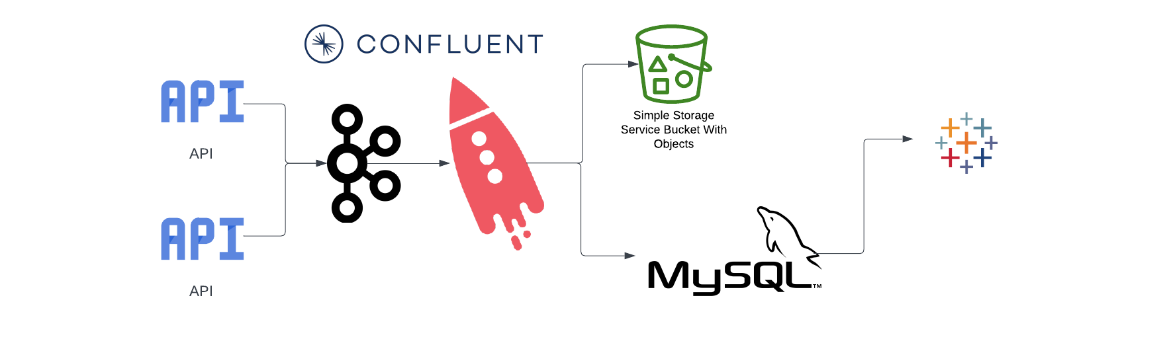

Slide 3
Apache Kafka
Apache Kafka is a distributed streaming platform that is used to build real-time data pipelines and streaming applications
Kafka is built around the concept of topics, which are streams of records. Producers write data to a topic, and consumers read data from a topic. Kafka also provides features like replication, partitioning, and data retention, which make it a reliable and scalable platform for handling large volumes of data.
Kafka offers exactly-once messaging semantics, and it achieves this with its transactional API offering.

Slide 4

ksqlDB
A database for building real-time applications that leverage stream processing
Features:
Joins
Aggregates
Push & Pull Queries
Filters
UDF
Connectors

Slide 5
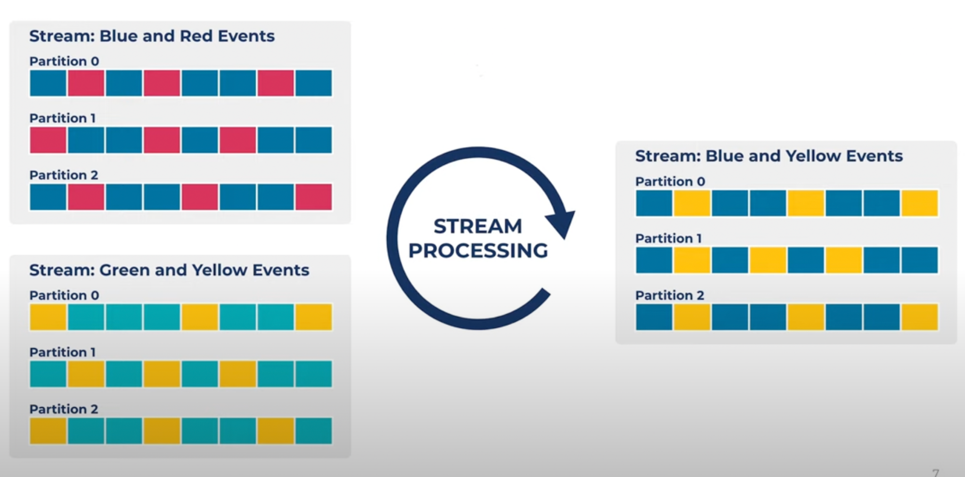
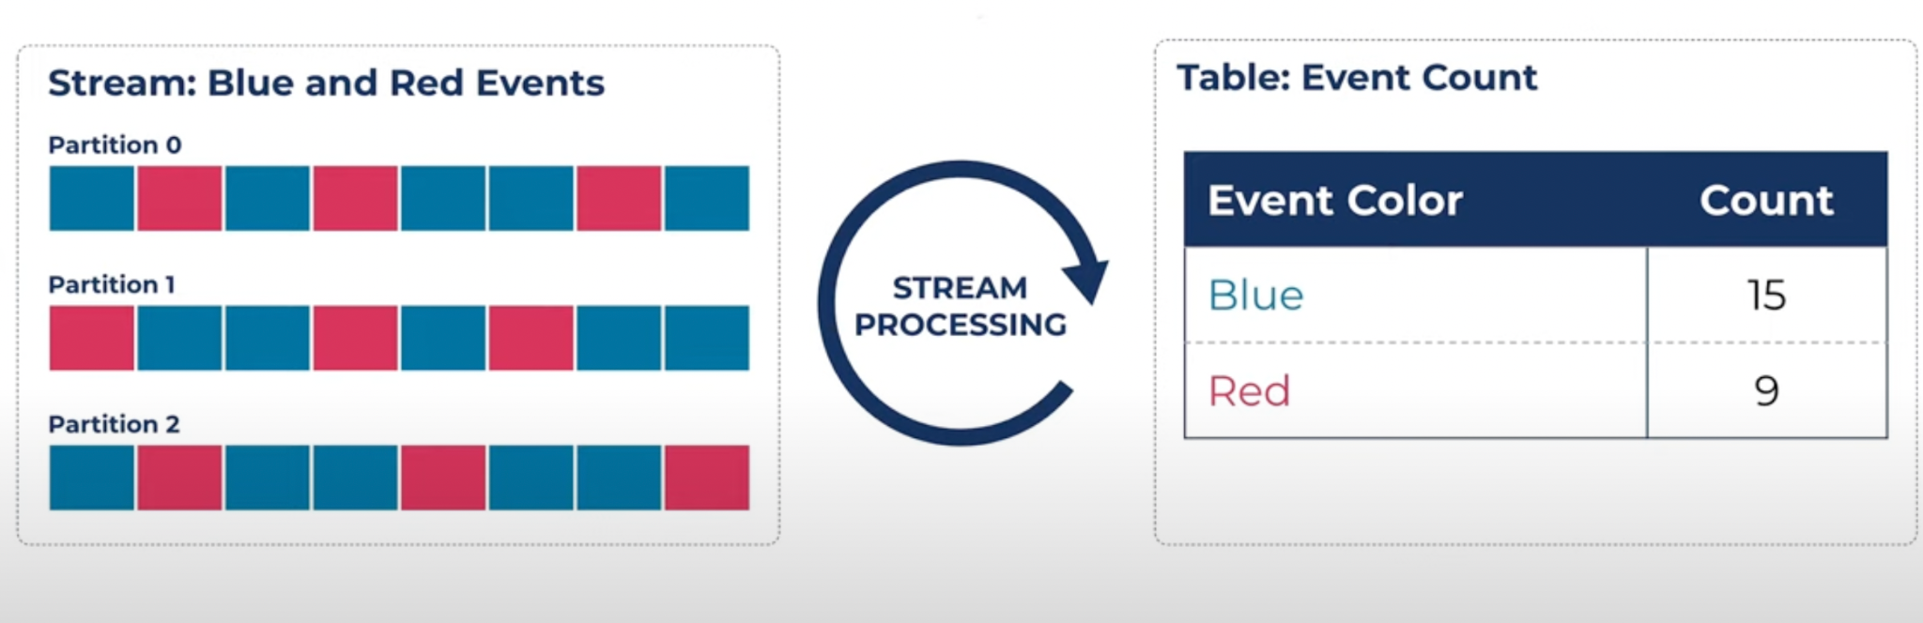
ksqlDB

Slide 6
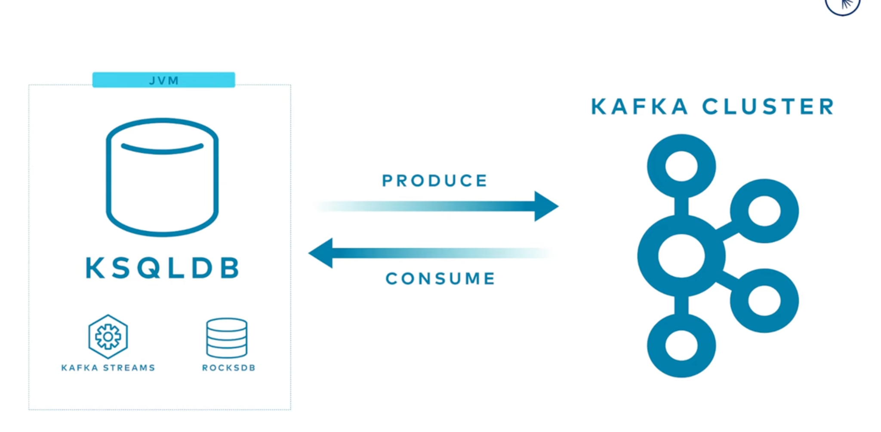
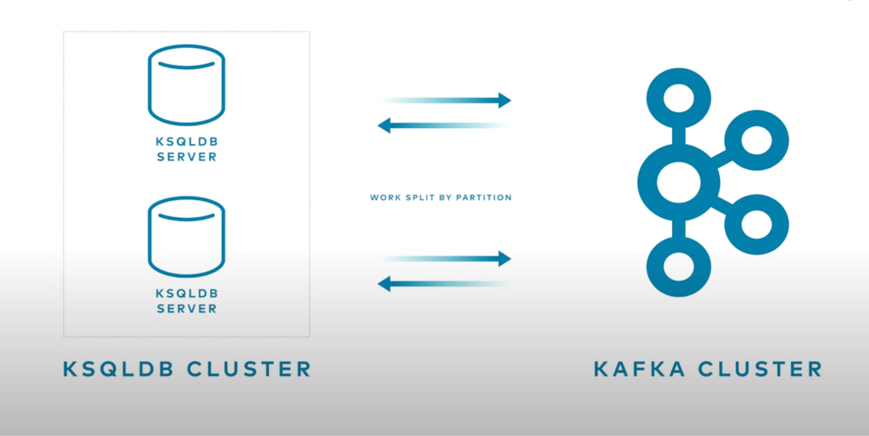
Notes:
ksqlDB is built on top of Streams and uses RocksDB as state store. A distributed system that uses partitions to scale workload - clusters.
ksqlDB paralyzes throughput by allocating partitions to different nodes.
ksqlDB handles compute, kafka handles storage - two tier architecture - elastically scaled independently from one another

Slide 7
Streams vs Tables
Stream is an unending stream of events
Table is a stateful entity and keeps track of the latest value for each key
CREATE [OR REPLACE] [SOURCE] STREAM [IF NOT EXISTS] stream_name
( { column_name data_type [KEY | HEADERS | HEADER(key)] } [, ...] )
WITH ( property_name = expression [, ...] );
WITH (
KAFKA_TOPIC = 'my-users-topic',
VALUE_FORMAT = 'JSON');

Slide 8
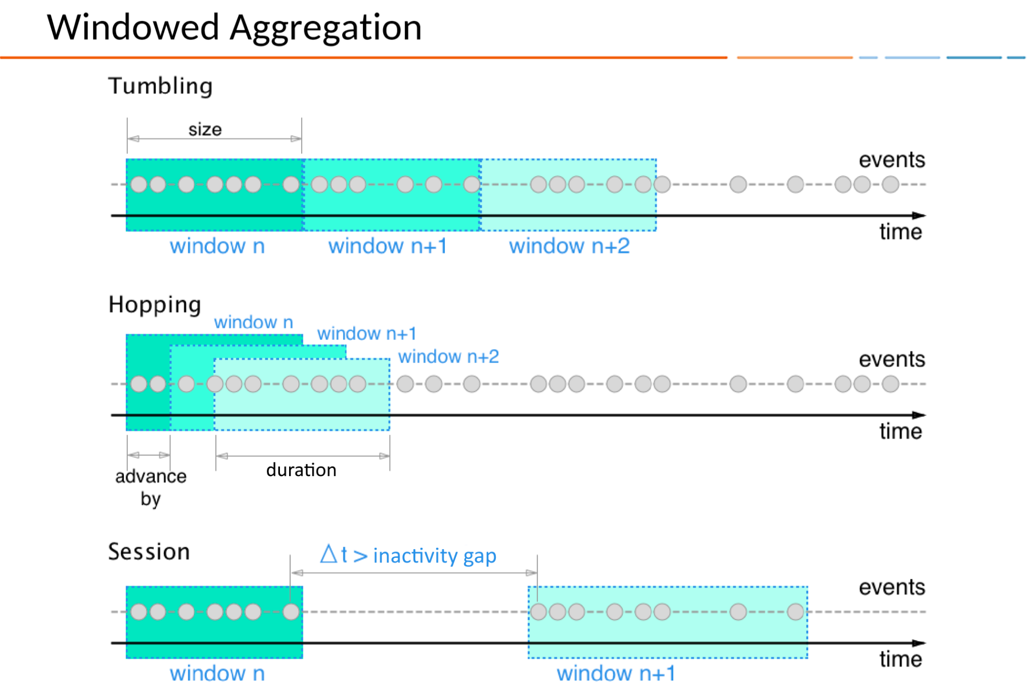
Windows

Slide 9
Business Questions
Which airlines fly most to Boston?
How many flights are delayed per (minute/hour/day)?
What are the most popular arrival destinations?
Which airports are people flying from?
Which airline has the most delayed flights?

Slide 10
References
https://developer.confluent.io/learn-kafka/ksqldb/intro/

